Slide 1

Medico-Legal Duties of JMO/MO ML
Dr. Handun P. Wijewardena
MD (USSR), DLM (Colombo)
MD [Forensic Medicine] (Colombo)
Consultant JMO
Teaching Hospital
Ragama
16.06.2016

Slide 2
MANUAL ON MANAGEMENT OF DISTRICT HOSPITALS, PERIPHERAL UNITS AND RURAL HOSPITALS
MINISTRY OF HEALTH AND WOMEN’S AFFAIRS
COLOMBO (SRI LANKA)
1994
Dr. Reggie Perera
Deputy Director General of
Health Services (Medical Services)
Dr. Joe Fernando
Secretary
Ministry of Health and Women’s Affairs

Slide 3
The Medical Officer must attend to the
Clinical Medico-Legal examinations,
Medico-Legal postmortem examinations,
Exhumations,
Visiting Scenes of Crime and the
Recording of Dying Declarations.

Slide 4
WHEN TO SEEK HELP OF CONSULTANT JMOO
If any difficulty arises in carrying out such examinations, due either to complexity of the case or the inexperience of the Medical Officer, then the Medical Officer concerned must inform such authority that ordered/ requested such examination, in writing, giving reasons for his/her inability to carry out such examination and also advise such Authority to refer the case to the nearest Judicial Medical Officer.

Slide 5
MEDICO-LEGAL EXAMINATIONS (CLINICAL)
Medical Officers in-charge of Institutions must give information to the Officer in-charge of the nearest Police Station, regarding admission or treatment of patients following
intentional violence,
sexual assaults,
accidents,
poisoning or
any other situation where there is reasonable ground to suspect that a crime had been committed.

Slide 6
Medico-Legal Clinical Examinations are carried out in the following circumstances:­
(i) Request of a Police Officer:-
Medico-Legal Examination Forms (Police-20) are issued to injured persons by the Police Department in cases of intentional violence, sexual assault, road traffic accidents, industrial accidents, poisoning, drunkenness, consumption of drugs, insanity etc.
After the examination, the Medical Officer must hand over to the Police Department, his report in the police copy of the Medico­ Legal Examination Form as soon as possible.
ii) Orders of Judges, Magistrates and other Judicial Officers:­
Reports on these examinations must be sent in the Medico-Legal Report Form (H 1135).

Slide 7
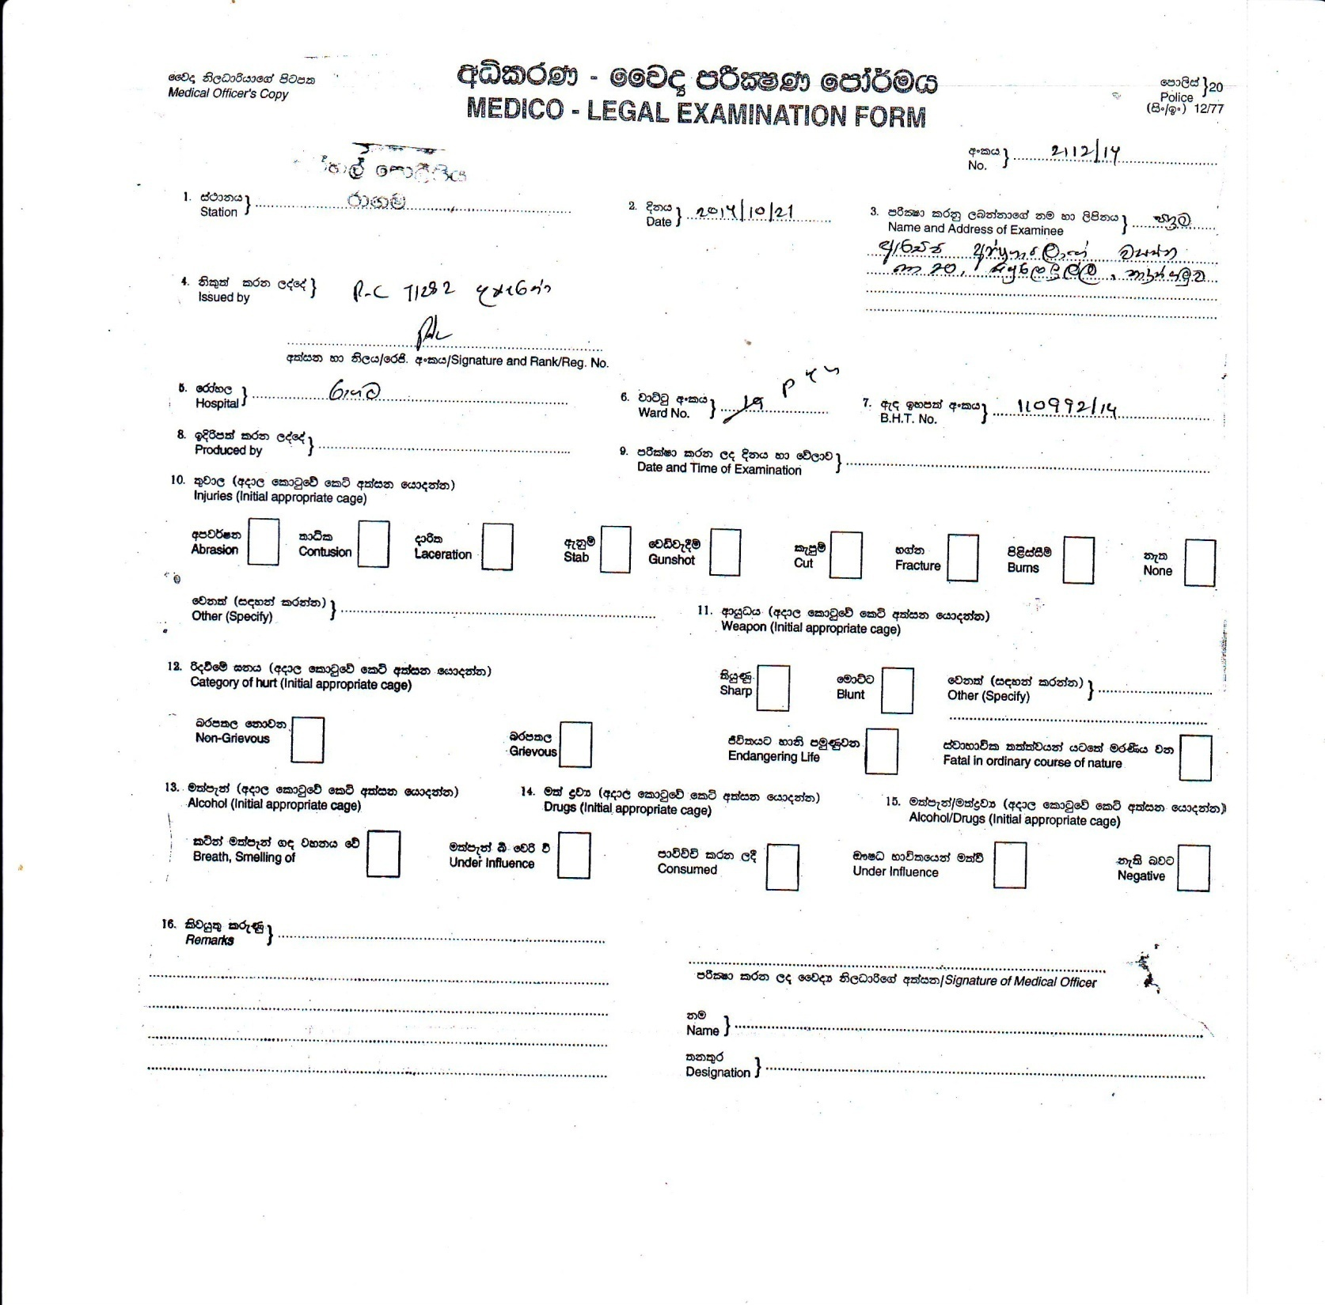

Slide 9
10
.
Nature of bodily harm:
Abrasion
Contusion
Laceration
Stab
Cut
Fracture
Gun shot
Burn
Bite
Dislocation/
Explosion
None
Subluxation
11.
Others (specify):
1
2.
Age
of wounds:
Fresh
Re
cent
/healing
Old
/healed (scars)
1
3.
Causative agent /
Weapon (Initial appropriate cage)
:
Blunt Sharp
Firearm Explosion/Blast
Other
1
4.
Category of Hurt
15.
Medical Condition of the examinee affecting the life
:
Non
Endangering Life
-
grievous
Grievous
Fatal in the ordinary course of nature
1
6
. Examination for consumption of alcohol:
17
. Examination for consump
tion of
drugs
:
Breath smelling
Consumed
Under influence
Under influence
No clinical features
No clinical features
18.
Findings of examination
for alleg
ed sexual assault
Features of
penetration
of genitalia
were present
Features consistent with intra labial penetration
were
present
Features consistent with anal penetration were present
Features consistent with oral penetration were present
No medicall
y detectable sings can be anticipated according to the given history
17.
Remarks & Opinions :
Signature of the Medical Officer :
Full Name
Designation :

Slide 10
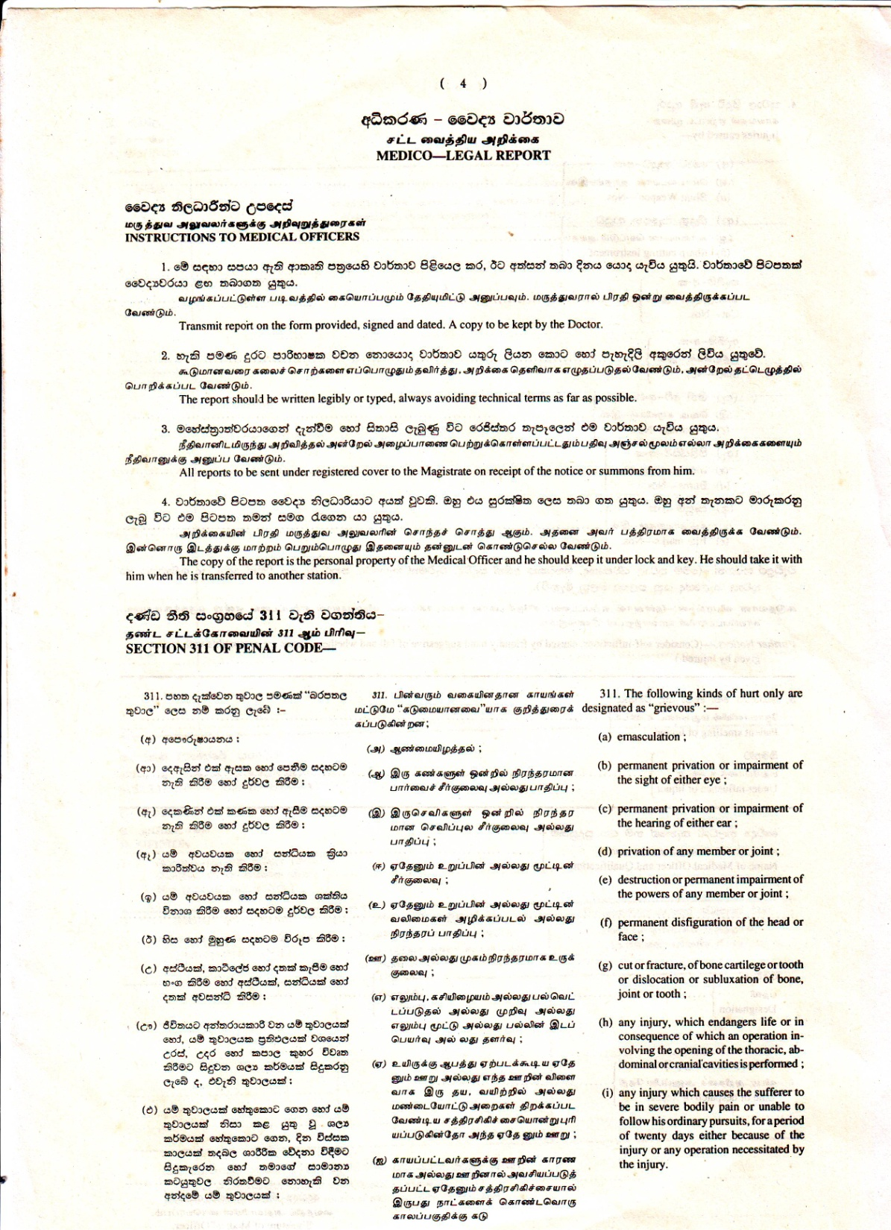

Slide 11
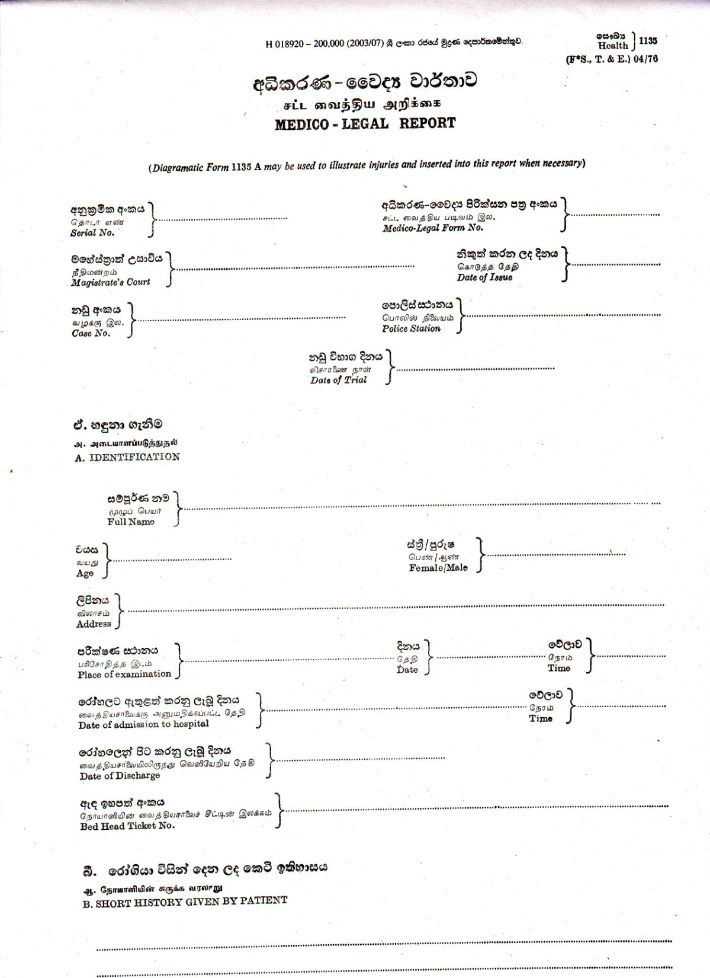

Slide 12
CLINICAL MEDICO LEGAL EXAMINATION-STEPS
(1) History from the patient, as to the circumstances that led to the present condition.
(2) Physical examination as regards Nature, Size, Shape, Disposition and Site of Injury.
(3) General Physical Examination.
(4) Conducting Relevant Investigations.
(5) Referral of Patients to Specialists, as necessary.

Slide 13
MEDICO-LEGAL POSTMORTEM EXAMINATIONS
These examinations are ordered by a Judge/Magistrate or an Inquirer-into-Sudden Deaths. They should be carried out promptly. Before performing the postmortem examination, the Medical Officer should see that the body is identified by two persons acquainted with the deceased.
The examination must be complete. The internal examination must include, opening into all body cavities and dissecting all organs therein.
All dissected internal organs must be put back into the body cavities and sewn up before the body is handed over to the relatives.
If the Medical Officer has removed any organs for further studies, he should make a note of such organs removed in the postmortem examination report.

Slide 14
In Postmortem examinations where the cause of death is not established at the end of the examination, it is mandatory to take specimens from all vital organs for Histology (Preserved in 10% Formalin solution) and also to remove specimens for Toxicological analysis.
Soon after the completion of the postmortem examination, the Cause of Death and other relevant opinions must be communicated to the Judicial Authority.
The Medical Officer must enter all the postmortem examination findings in the Postmortem Examination Report Form (H 42).

Slide 15
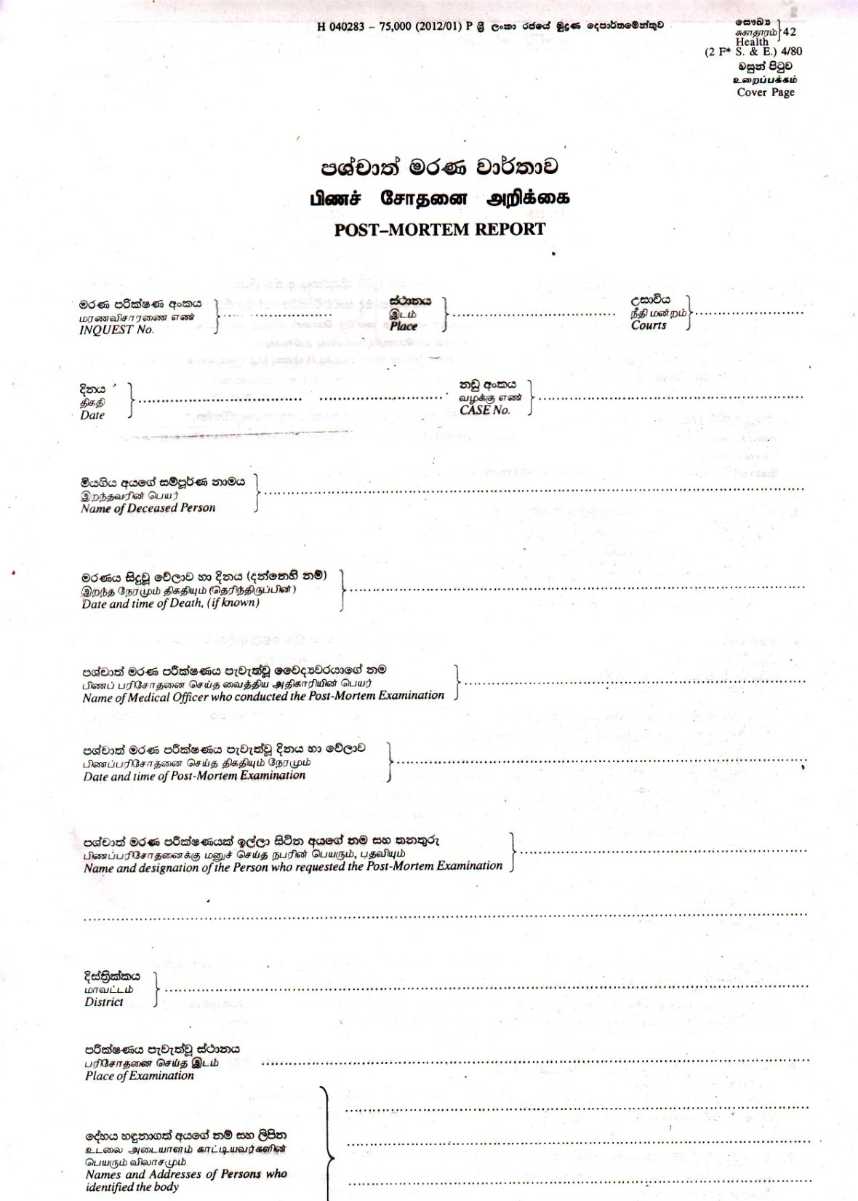

Slide 16
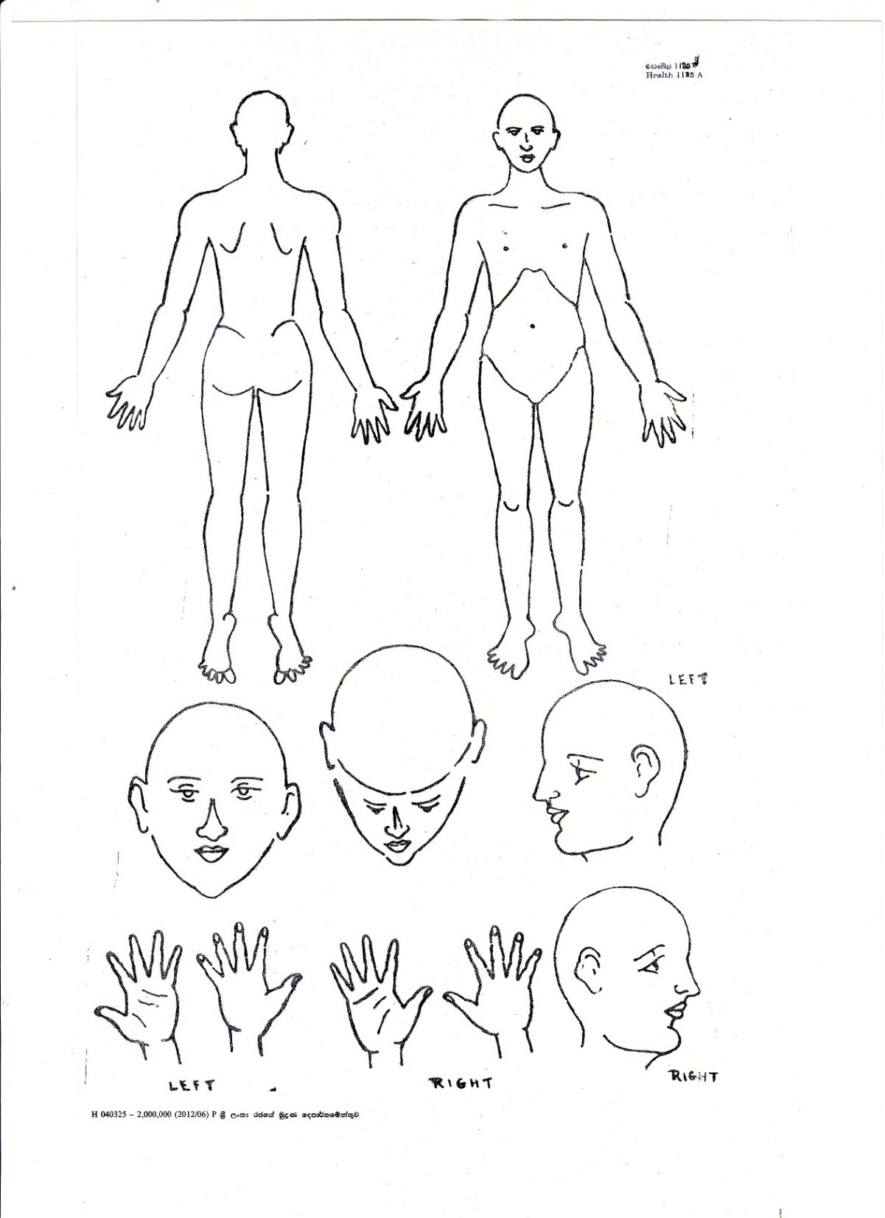

Slide 17
All Medico-Legal Postmortem Examinations should be carried out in Mortuaries with basic facilities like a postmortem table, running water and adequate light.
Such examinations should not be carried out after sunset in artificial light.
However if the Medical Officer is of the opinion that the delay in keeping the body overnight will adversely affect the Medico-Legal investigation, then he may carry out such investigation provided there is adequate artificial light.

Slide 18
EXHUMATIONS
Acting under Section 373 (2) of the Criminal Procedure Code, a Judicial Authority may order a Government Medical Officer to exhume a body and carry out a postmortem examination.
An inexperienced Medical Officer may not be competent to carry out a postmortem examination on an exhumed body.
In such situations, a Medical Officer may carry out only the exhumation of the body and advise the Judicial Authority to refer the postmortem examination to a Judicial Medical Officer.

Slide 19
VISITS TO SCENES OF CRIME
All Medical Officers must visit scenes of crime at the earliest opportunity if such a request is made by a Police Officer or a Judicial Authority. Failure or delay in visiting a scene of crime can result in loss of Scientific Data vital for the investigation.

Slide 20
DYING DECLARATIONS
In the case of serious injury following intentional violence where, in the opinion of the Medical Officer, the patient may die before his statement is recorded by a Police Officer, then the Medical Officer in-charge of the Institution must inform the Magistrate of the area through the Officer-in-charge of the nearest Police Station to record the dying declaration of the patient.
If however, death is imminent then the Medical Officer-in-charge of the Institution must take down in writing the statement made by the person seriously injured with particular reference to the name of assailant, nature of weapon used and place, date and the time of sustaining such injuries.

Slide 21
REPORTS, RECORDS AND FEES
(1) All notes of examinations must be made clearly and legibly, in the prescribed forms.
(2) All reports sent to Courts or any other Judicial Authority must be in duplicate. A copy must be kept by the Medical Officer.
(3) Notes and reports of examinations made by the Medical Officer, is his/her personal property and must be kept under lock and key. The Medical Officer should take it with him/her when he/she is transferred to another Institution.
(4) All notes and reports must be preserved for at least 25 years.

Slide 22
(5) Bed Head Tickets, X-rays and other reports pertaining to Medico Legal cases must be preserved in the institution for a period of at least 25 years.
(6) On receipt of the notice or summons from a Judicial Authority to forward a report to Court or when a request for a report is made by the Attorney General or the Police Department, the Medical Officer must make such report available without delay.
(7) Private Medical Reports (MLR & PMR) can be issued only at the written request of the affected person or his next of kin when such person is severely disabled or dead. A private Medical Report cannot be issued to a third party.

Slide 23
(8) Separate Registers must be maintained for
(a)Clinical Medico-Legal Examinations
(b) Postmortem Examinations
(9) Fees are payable by the respective High Courts for submitting Medico-Legal Reports to Courts (H-1135) after the examination of a patient and for conducting and submitting a report in H-42 after postmortem examinations, under section 373 (1) & the Criminal Procedure Code.

Slide 24
WHAT IS A MEDICO-LEGAL CASE?
No legal definition
Pre-labeled case: It is a case of injury or ailment where an attending doctor after taking history and clinical examination of the patient thinks that some investigation by law enforcing agencies is essential.

Slide 25
A doctor can receive a medico-legal case–
Brought by the police for examination and reporting.
Already registered MLC referred from other health care system for expert management/advice
After history taking and thorough examination, if the doctor suspects that the circumstances/ findings of the case are such that registration of the case as an MLC is warranted
Directive of court.

Slide 26
ML cases may be
A). Clinical
B). Pathological
A). Clinical forensic medicine-
Injury description, dating of injuries, giving scientific opinion on causative weapon/s, deciding the category of hurt.
Age estimation
Calculation of degree of disability for insurance purposes

Slide 27
4. Opinion on circumstances – self infliction/accidental etc
5. Assessment of mental state
Criminal
Whether fit to plead
Testamentary capacity
Ability to give valid consent

Slide 28
6. Examination & reporting of
sexual abuse cases
Torture
GBV
firearm & explosives
Criminal Abortion
Child abuse
Alcohol intoxication

Slide 29
7. medical negligence
8. Compensation
9. Medical Ethics

Slide 30
B). Forensic Pathology:
Perform autopsy & answer the followings:
1. COD When there are injuries (unnatural deaths)
2. COD in Sudden unexpected deaths
3. Causation of injuries - force, position of victim & assailant etc.

Slide 31
Purpose of postmortem examination:
1. Collect evidence for Identification
2. Arrive at COD
3. If there are injuries – Nature, size, site, shape & category of hurt
4. Time since death
5. Evidence of poisoning
6. Detect pre-existing diseases and their contribution to the death

Slide 32
7. Manner of death
8. Infant deaths – IUD/ death during delivery/death following injuries
9. Collecting samples for analysis
10. prepare a comprehensive report to the courts
11. Reports for insurance purposes
12. supporting for public health & safety.

Slide 33
Medico-Legal duties (Any doctor)
Identify the medico-legal cases
Inform police/JMO
Collecting and preserving trace material that can be lost.
Taking consent
Witness in reporting dying declaration
Duty of care

Slide 34
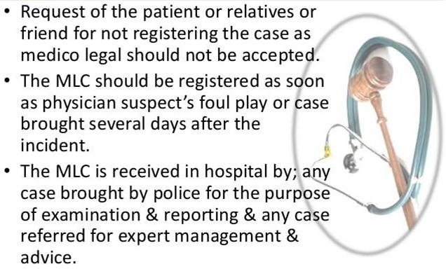
MEDICO-LEGAL CASE

Slide 35
Medico-Legal Cases When to Inform Police & JMO
All cases of injuries (RTA, rail accidents, factory accidents, unnatural mishaps)
Suspected or evident homicides or suicides
Sexual assault cases
All cases of burns
Alleged cases of assaults
All cases of suspected poisoning/intoxication
Cases referred from court

Slide 36
Cases of suspected/evident criminal abortion
Cases of unconscious/comatose where its cause is not natural and unknown
Cases of self-inflicted injuries or attempted suicide
Cases brought dead/dead on arrival/sudden unexpected death
Need to do:
Notification to police
Collection & preservation of samples
In critical cases - Recording of dying declaration.

Slide 37
Time limit for registering a Medico legal case
A medico-legal case is registered as soon as a doctor suspects foul play or feels it necessary to inform the police, at any time after admission.
A case is registered as a MLC even if it is brought several days after the incident.

Slide 38
Can a doctor refuse to attend MLC ?
NO
GOVT SERVICE DOCTORS -DUTY BOUND
ROLE OF PRIVATE PRACTITIONERS?
A doctor cannot refuse to examine medico legal case on the basis of being a private practitioner or citing a jurisdiction problem.

Slide 39
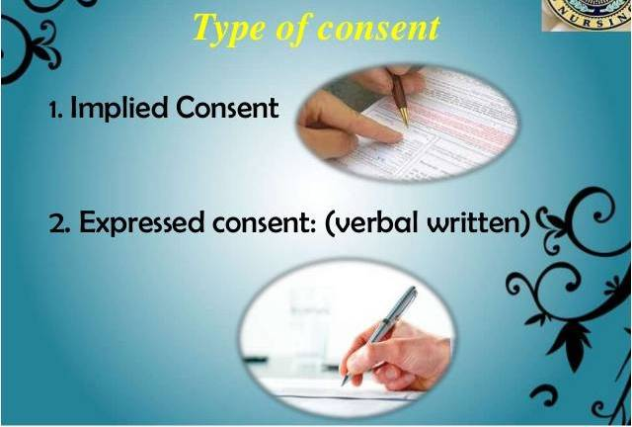

Slide 40
Informed consent:
Informed consent in ethics usually refers to the idea that a person must be fully informed about and understand the potential benefits and risks of their choice of treatment.
If the patient is incapacitated, next of kin make decisions for them.
The value of informed consent is closely related to the values of autonomy and truth telling.

Slide 41
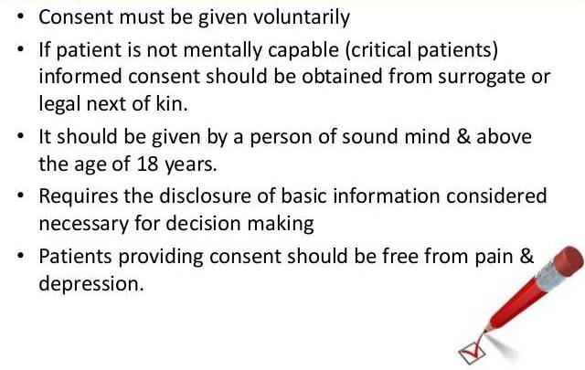
Consent

Slide 42
Take consent of patient or relative (if patient is unconscious/minor/mentally ill) for any kind of procedure/treatment.
Allow the relative to be with the patient if indicated.
Avoid answering enquiries to insurance agents.
The condition of the patient should be reported verbally only.
Do not provide information to police/media or any other public agent.
The Director of the hospital has the power to divulge the information to other party.

Slide 43
DETAILS OF EXAMINATION
Alleged history – what, who, when, where ?
To be precise and to the point
Legibly/clearly written
Description of injuries
Abbreviations avoided
When in doubt consultation obtained
Minor injuries also noted in case of polytrauma / multiple injuries

Slide 44
COLLECTION AND PRESERVATION OF SAMPLES
Gastric lavage/ vomitus in poisoning cases
Blood in alcoholic/poisoning cases/drug abuse or for DNA test
Clothes in assault/injury/fire-arm/burn cases
Nail clippings in assault/rape cases
Pellets/bullet etc. if recovered
Vaginal swabs/public hair in rape cases
Swabs in un-natural sexual offence cases
Swabs from fire-arm entry wounds
Washing from hands in fire-arm suicide cases

Slide 45
Urine for pregnancy test in rape cases
Undergarments
Swabs from glans penis in rape/unnatural sexual offences
Swab from bite marks for blood/DNA test
Nails and hair in chronic poisoning of heavy metals
Any other material which may be useful in investigation
Any other exhibit e.g. bottle of poison or tablet or weapon if recovered should be properly labeled and sealed. It is essential to give sample of seal on separate cloth/paper putting initials. The endorsement of sample of seal should also be made in MLR.

Slide 46
Death of a person admitted as a medico-legal case
The following are the do's and don'ts in case a person admitted as a medico-legal case expires.
Police Informed immediately.
Body sent to the hospital mortuary for preservation, till the legal formalities are completed and the police releases the body to the lawful heirs.
Death certificate not issued – even if the patient was admitted.
Dead body never released to the relatives directly

Slide 47
BROUGHT IN DEAD PATIENTS
Police to be informed if not already done
No injuries noted in MLC record
Articles in possession documented and handed over to relatives/police
Dead body to be sent to hospital mortuary

Slide 48
In case of a death in ward
Confirm death – Date and time
Write the cause of death or probable cause of death
Sign and write your name
Declaration of Death should be issued (only in natural deaths)
Summarise the presentation/history/medical and surgical procedures/treatment/diagnosis/causation of death and write to the MS/Director and send BHT to MS/Director’s office.

Slide 49
Requesting an Inquest:
The following deaths should be informed to the police:
Unnatural deaths (no need to write COD)
- Accidents
- Suicide
- Homicide
2. Rabies and other diseases following animal attack
3. COD unknown
4. Death under suspicious circumstances
5. Death in police custody, prison, mental hospital, leprosy hospital,

Slide 50
6. Death due to tetanus
Death due to criminal circumstances – abortion
Deaths under anaesthesia/after surgery
Death where allegation of medical negligence is levelled.
Deaths following industrial diseases
Write to MS/Director to authorize to hold the inquest.
Write to the police to make arrangements to hold the inquest.

Slide 51
Purpose of Inquest is not to find fault with staff and punish.
Order an inquest although you give the COD or probable COD, in suspicious cases.
ISD has power to release the body without requesting post mortem.
It is not your duty to order a post mortem.

Slide 52
Judicial PM:
- Done by JMO/MO (ML)/ DMO or designated MO on the order of the ISD or Magistrate.
Pathological PM:
- Done by the doctor who treated the patient.
- Can get the assistance of a doctor with experience in autopsy.
- COD is known.
- Aim is to gather knowledge about the pathological process of the disease to use in advancement of the science.
- No need to perform full autopsy.
- Need to get the consent of relations.

Slide 53
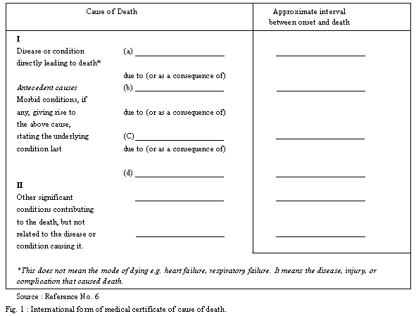

Slide 54
B 33

Slide 55
I a. Peritonitis .................................. 3 days
b. Perforation of Duodenal ulcer .. 1 week
(operation performed on ..... )
c. Chronic ulcer of duodenum ...... 4 years
II Oatcell carcinoma lower lobe of left lung

Slide 57
Admission & discharge of ML cases
Inform → Police/JMO
Records of the patient should be kept under lock & key.
Records should not be shown to other people other than the medical team.
All belongings of patient should be kept under safe custody.
If relatives or police want to get the belongings of patient → write the description of belongings → signature with thumb impression/relationship/ID number/Address
If there are collected body discharges, inform JMO before throwing.

Slide 58
Admission & discharge of ML cases
If MLEF is issued to a patient, the doctor/nurse cannot ask him to write on BHT “mata nadu awashya nehe” / “Niithimaya katayuthu awashya nene” and sign and go.
If the patient is in hurry, immediately call the JMO to see before discharge.
LAMA – is a patient’s right. If a MLEF is issued to patient advise him/her to go after seeing by JMO.
“Missing” from ward cannot be prevented. But the ward staff is responsible for that.

Slide 59
LAMA (Leave Against Medical Advice)
If the patient is in a critical condition, as a doctor, your responsibility is to:
Explain the critical condition of the patient to the relatives
Signature of the relative shoud be taken in which he/she writes that he/she is taking full responsibility to taking away the patient, that the doctors and nurses have explained the critical condition and the risk of taking away the patient.
In Transfer/LAMA, Diagnosis card or the management/investigations done should be provided to the patient.

Slide 60
Allowing the patient to go out and come back to the ward:
- Write to Director/MS indicating the necessity and period of time (only for a few hours) and got the permission.
Note down the time left.
Note down the time came back.
- Over night stay is not allowed.
- Check whether the close relations are aware of the necessity of going away.
If the patient comes on the following day, new BHT should be issued.

Slide 61
Admission & discharge of ML cases
On Discharge
If patient is transferred from one ward to another or any other hospital it should be clearly entered and signed.
Name and address of the relative should be noted before allowing the patient to leave hospital.
Original BHT or copy of BHT should not be given to any person.
Signature of the patient/relative should be taken on BHT before leave

Slide 62
Examination of Female patient
When a female patient is being examined by a male doctor, chaperon (nurse )must be available.
Maintain the total privacy during medical examination.
Expose the patient as little as possible
Protect the rights of the patient if she refuses to be examined by a male doctor
Repeated examination of breast, abdomen and perineal parts of patient unnecessarily should be avoided.

Slide 63
In case of sexual abuse
Use standard protocols and guidelines
Preserve samples-DNA profiling
Emergency Contraception if required
Treatment /prophylaxis as required
Opinion
Referrals to other specialists for management

Slide 64
CHILD ABUSE/ SUSPECTED VICTIMS OF SEXUAL ASSAULT/ABANDONED CHILDREN
Use the Guidelines laid down
A detailed description of assault/abuse history be mentioned
As far as practical –psychiatrist help be made available to victim
Report to be prepared as early as possible
Parents/ guardian whom child should trust should be allowed to be present

Slide 65
In case of results of examination are likely to be delayed the same should be mentioned
Emergency medical treatment/prophylaxis against STD to be provided when necessary
After examination child permitted to wash up and provide fresh clothing if clothing is taken as evidence
Preserve samples according to guidelines –SAFE [Sexual abuse Forensic Evidence] Kit provided in Govt. hospitals

Slide 66
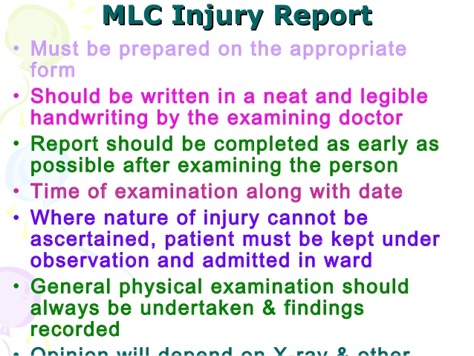

Slide 67
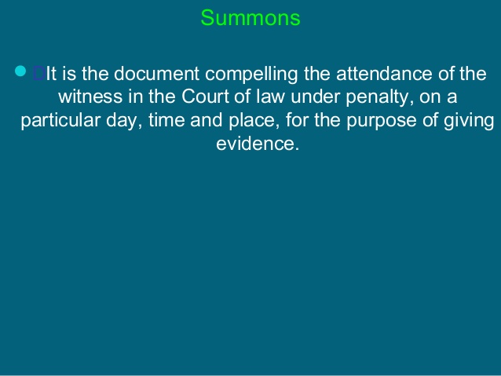

Slide 68
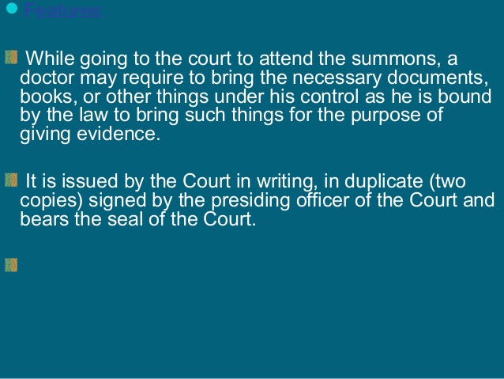

Slide 69
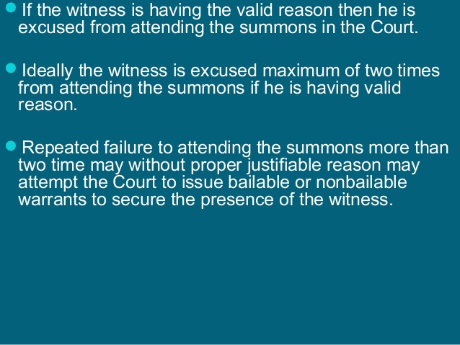

Slide 70
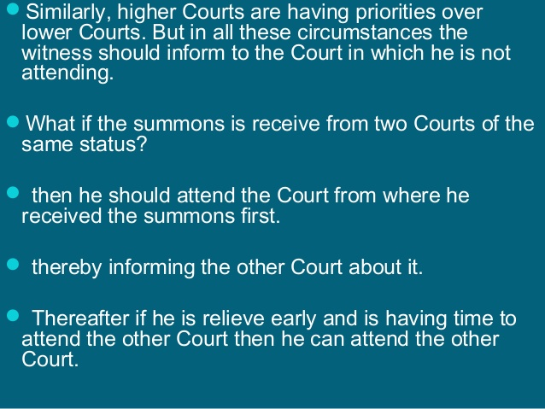

Slide 71
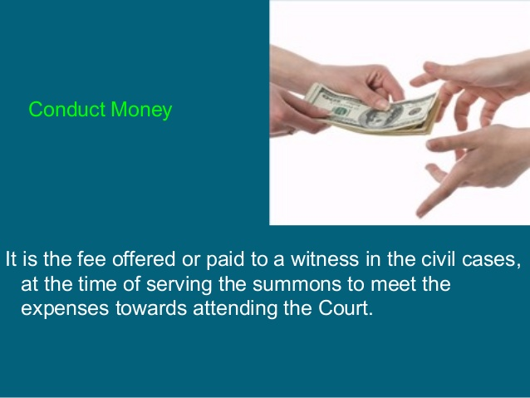

Slide 72
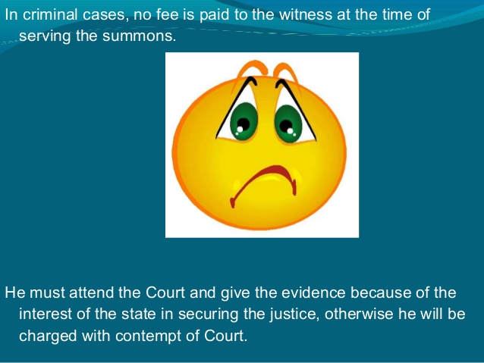

Slide 73
Dying declaration
It is a statement of a person, written or oral, who is dying as a result of some unlawful act.
- Doctor should assess that the patient is in good mental condition.
Declaration is made in question and answer form,
Noted down in patient’s language in the presence of two responsible witnesses
Signed by doctor, patient and witnesses.

Slide 74
Dying deposition
It is the statement of a dying person, before a Magistrate and the accused or his Counsel, on oath. (It is a bedside court)
Doctor has to certify the mental and physical fitness of the patient to make such a statement.

Slide 76
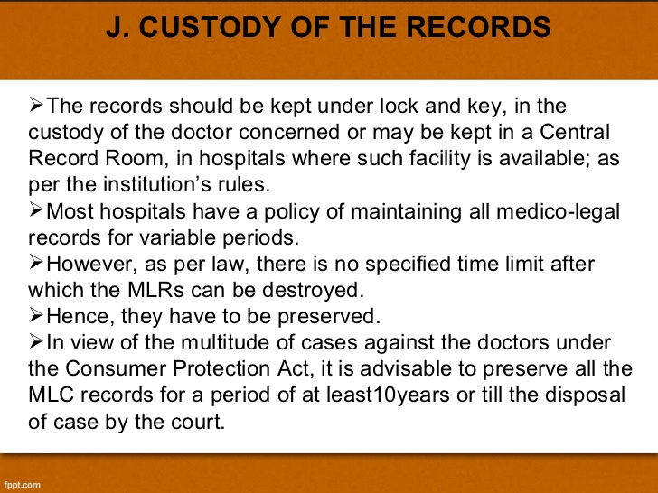

Slide 77
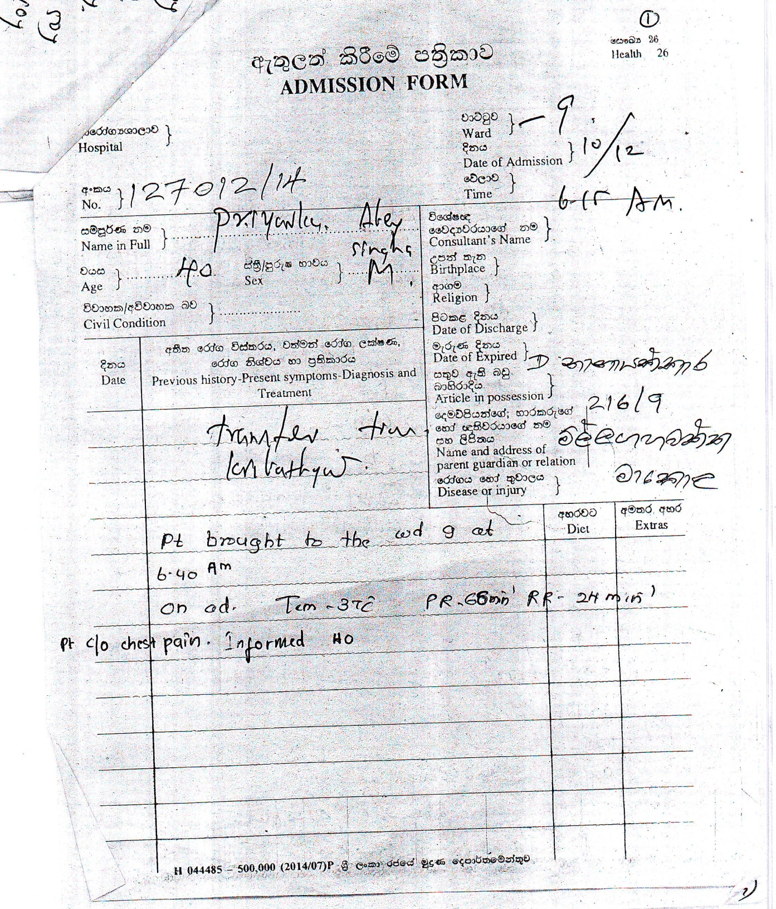
MI patient
C/o Chest pain
Not admitted to ETU
Not informed HO stat

Slide 78
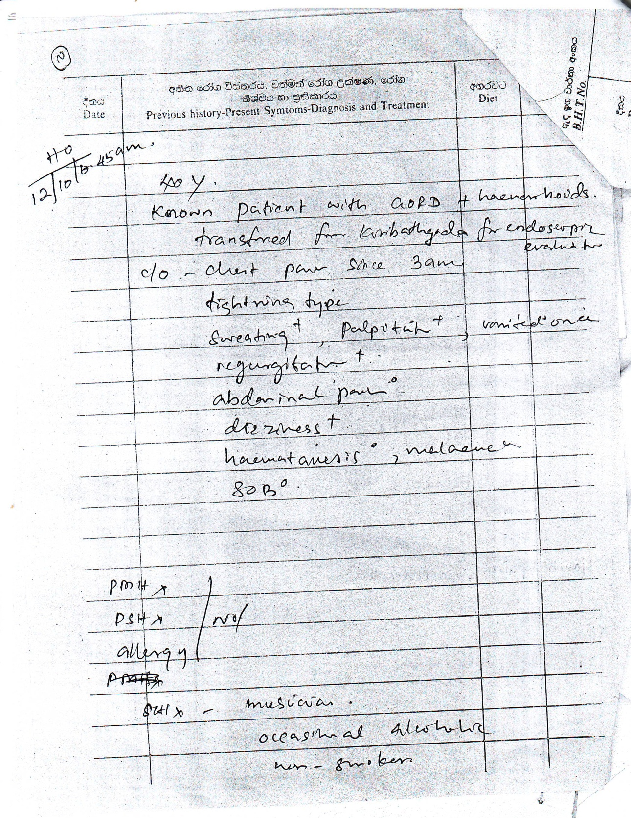
MI patient
C/o Chest pain
Not admitted to ETU
Not informed HO stat

Slide 79
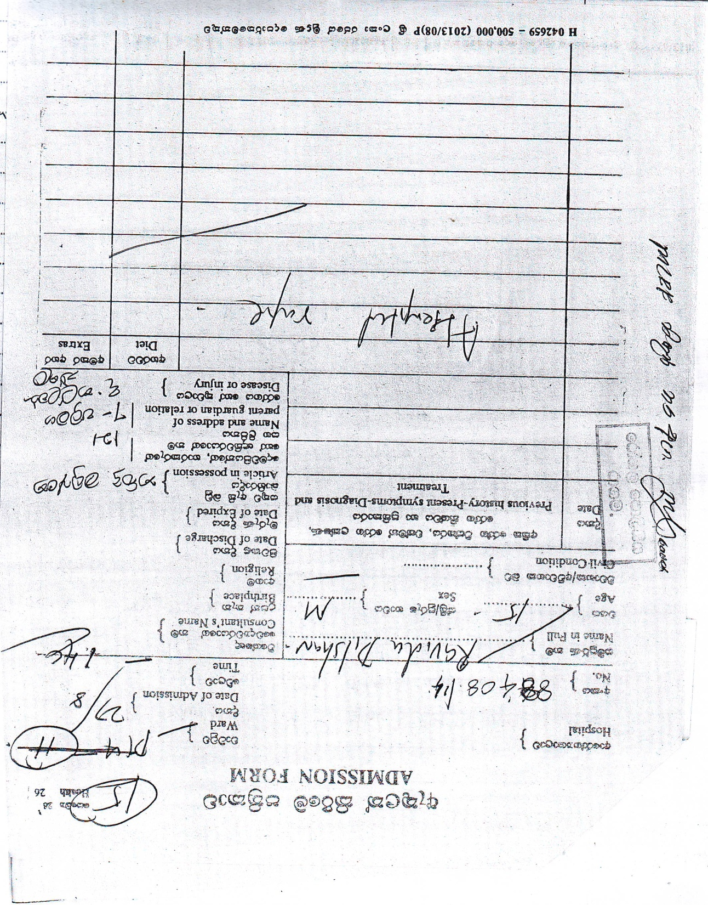
Ward not clear
Date incomplete
Time incomplete
Complaint – Not accepted
JMO/Police not informed

Slide 80
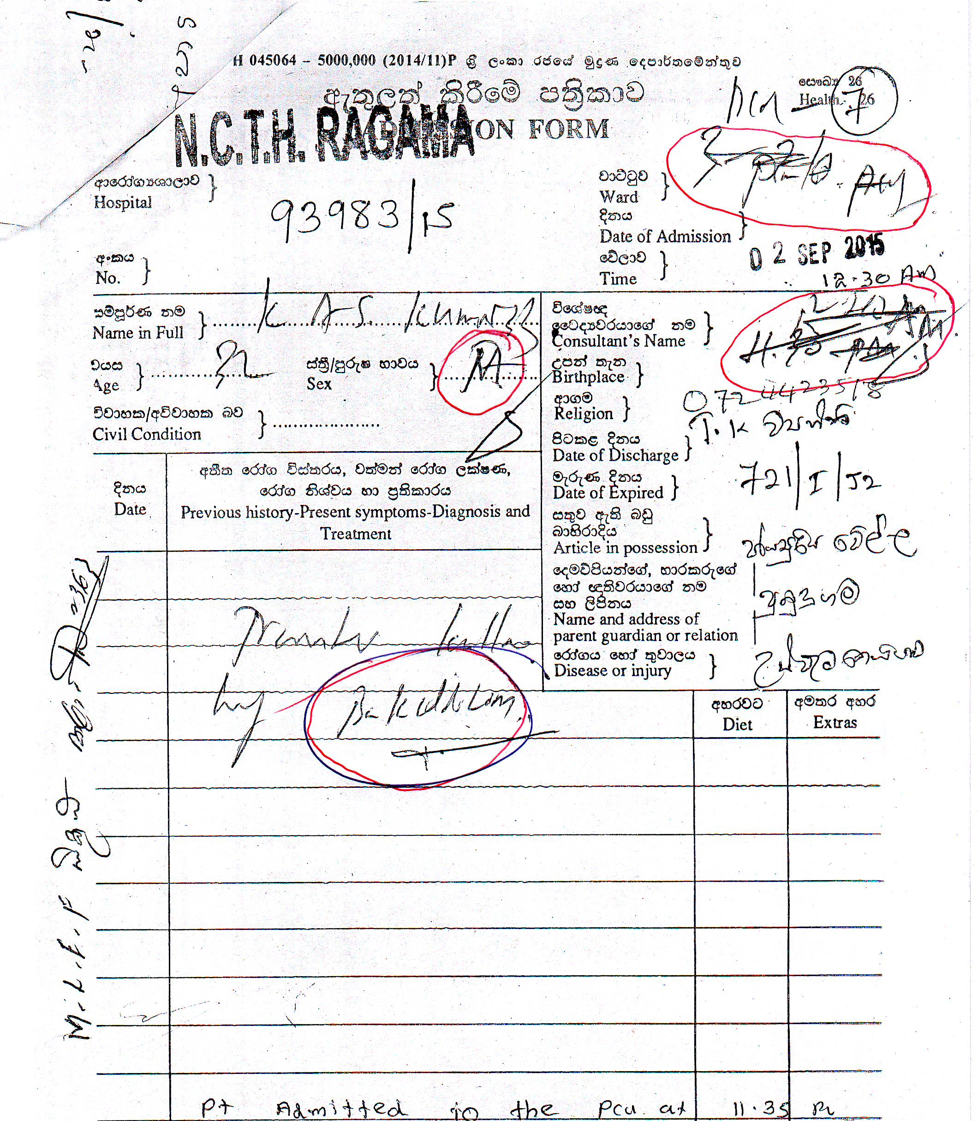
See the marked areas

Slide 81
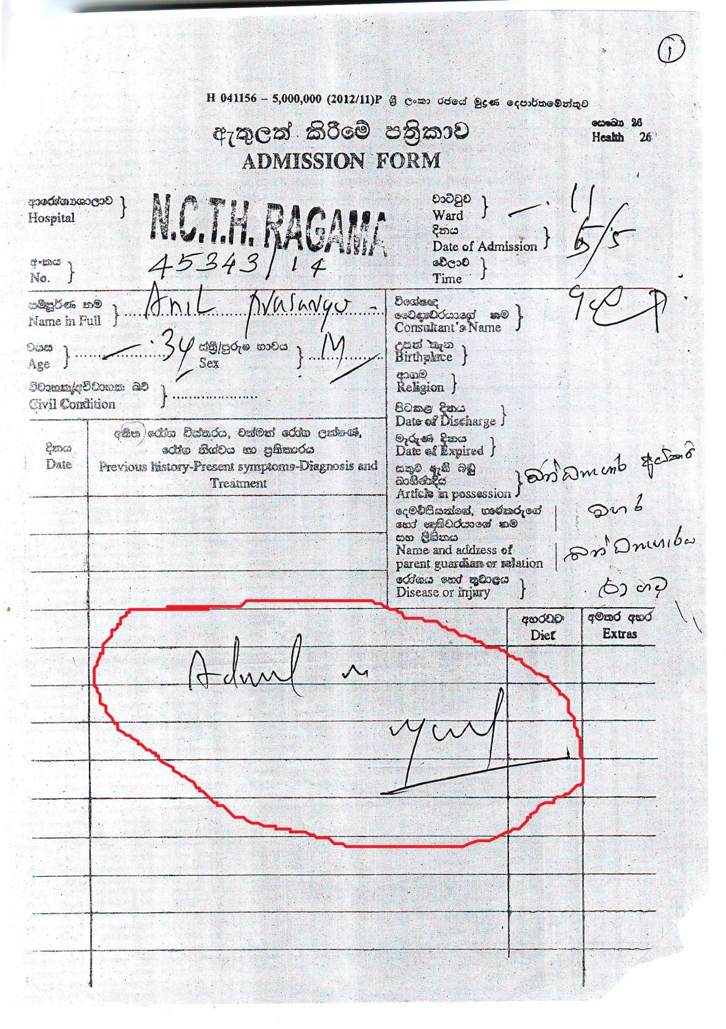

Slide 82
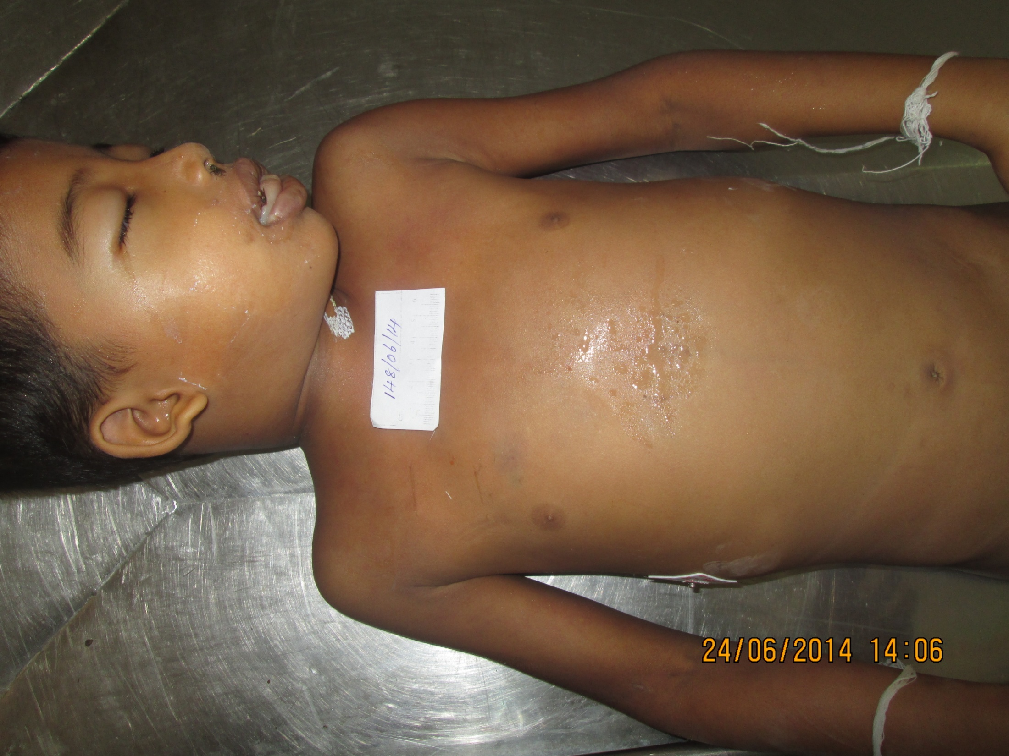

Slide 83
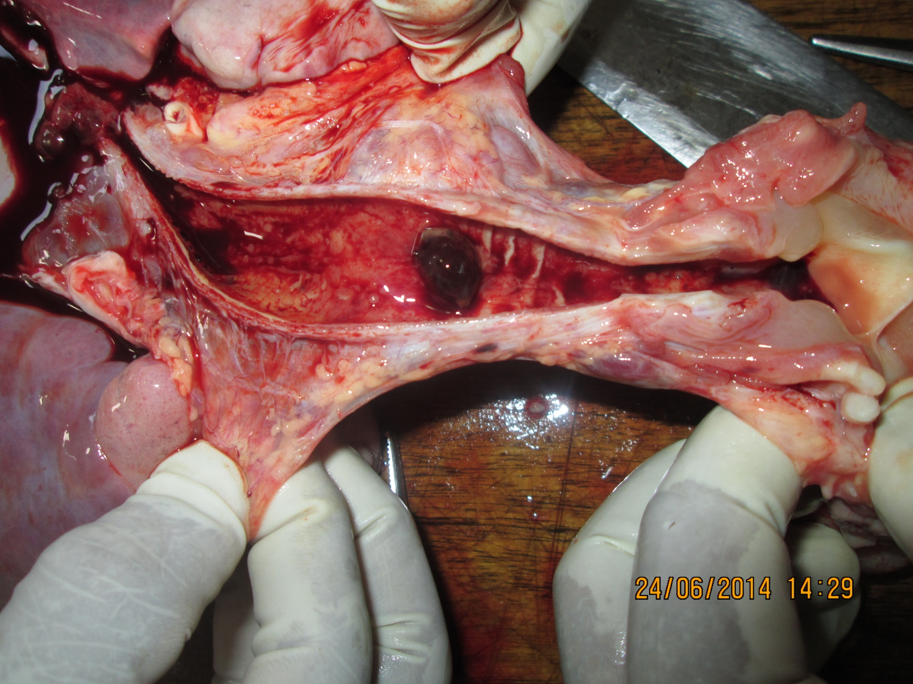

Slide 84
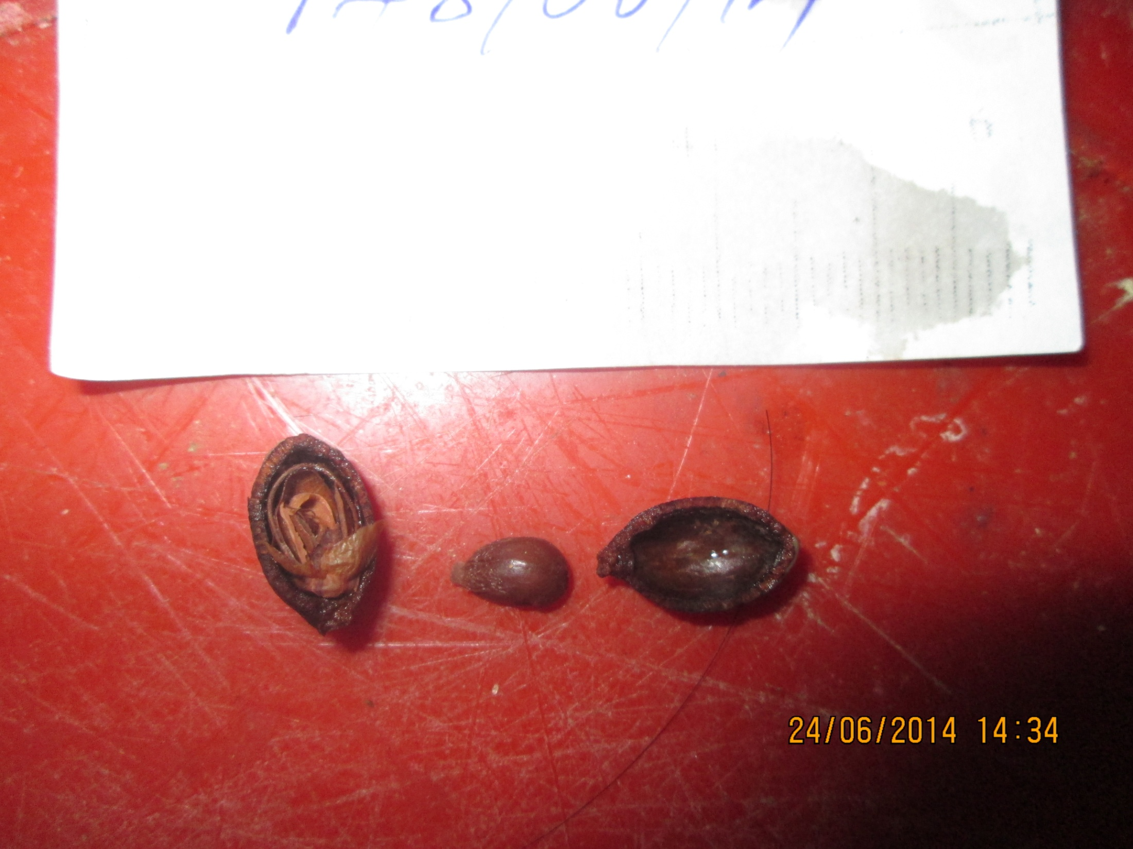

Slide 85
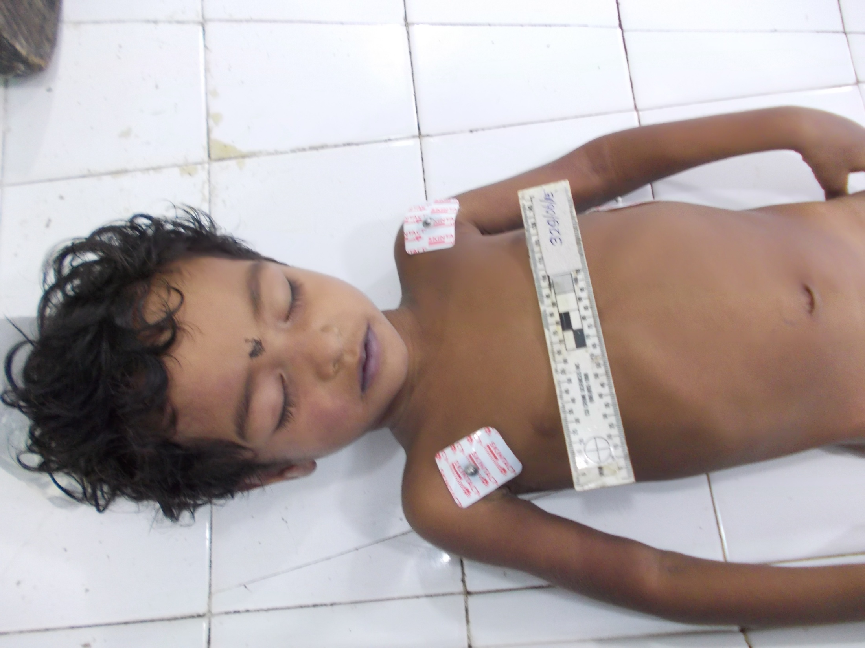

Slide 86
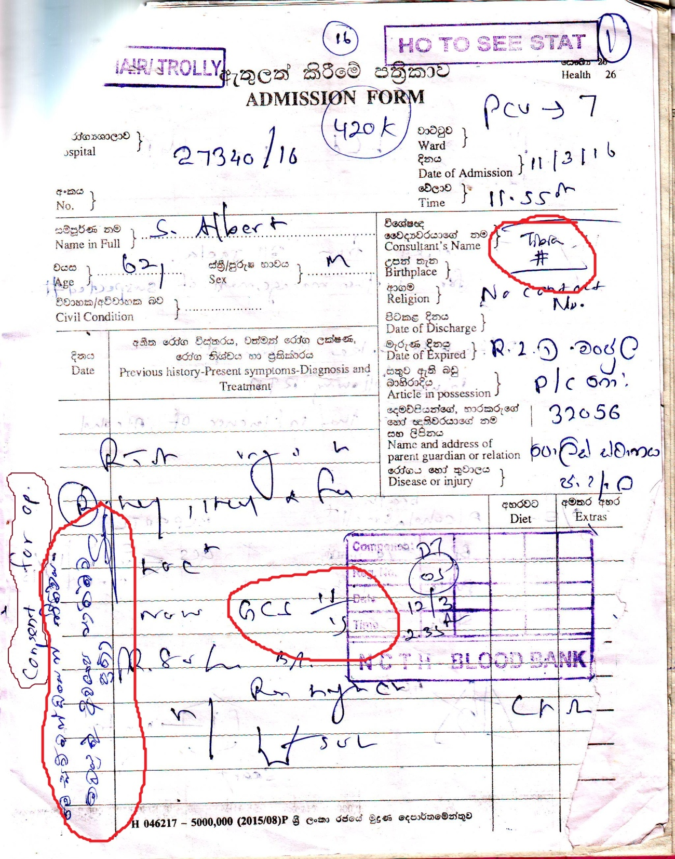

Slide 87
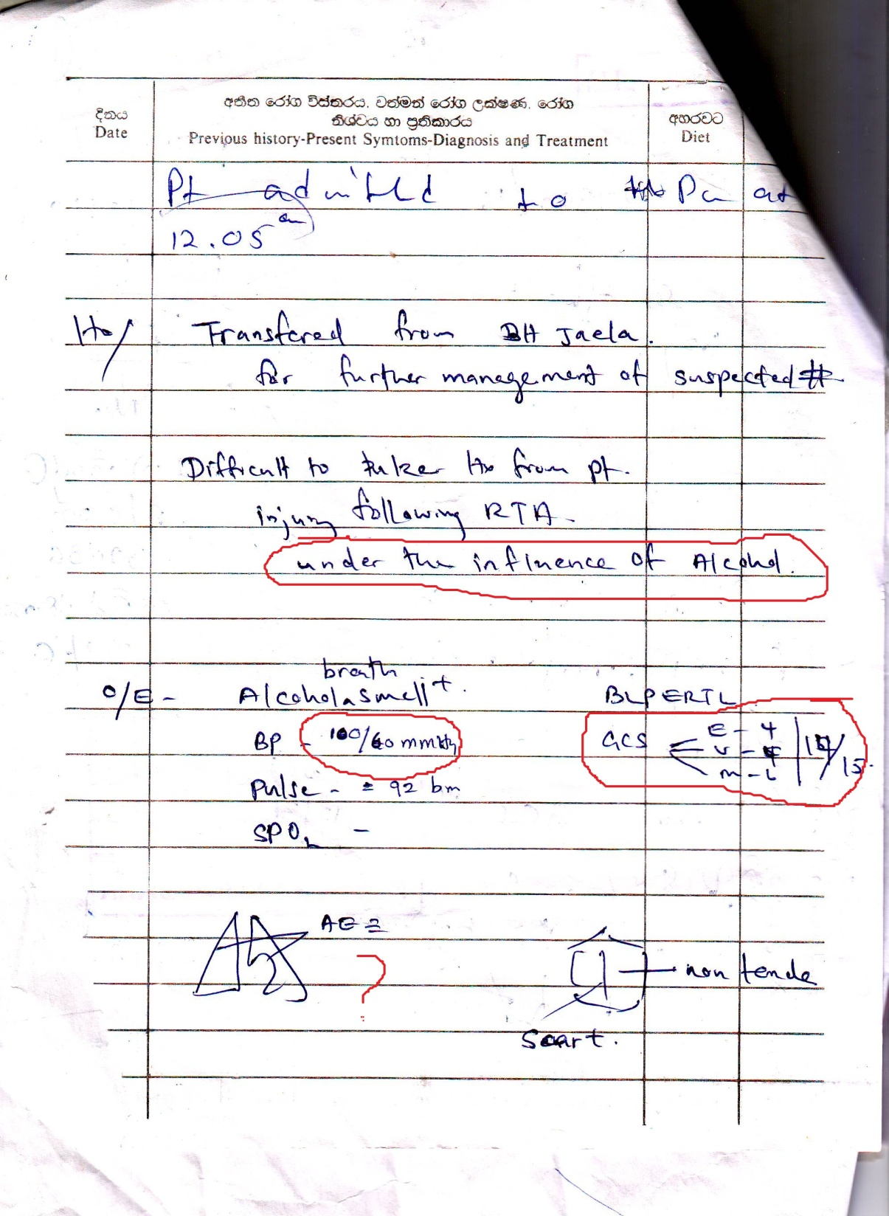

Slide 88
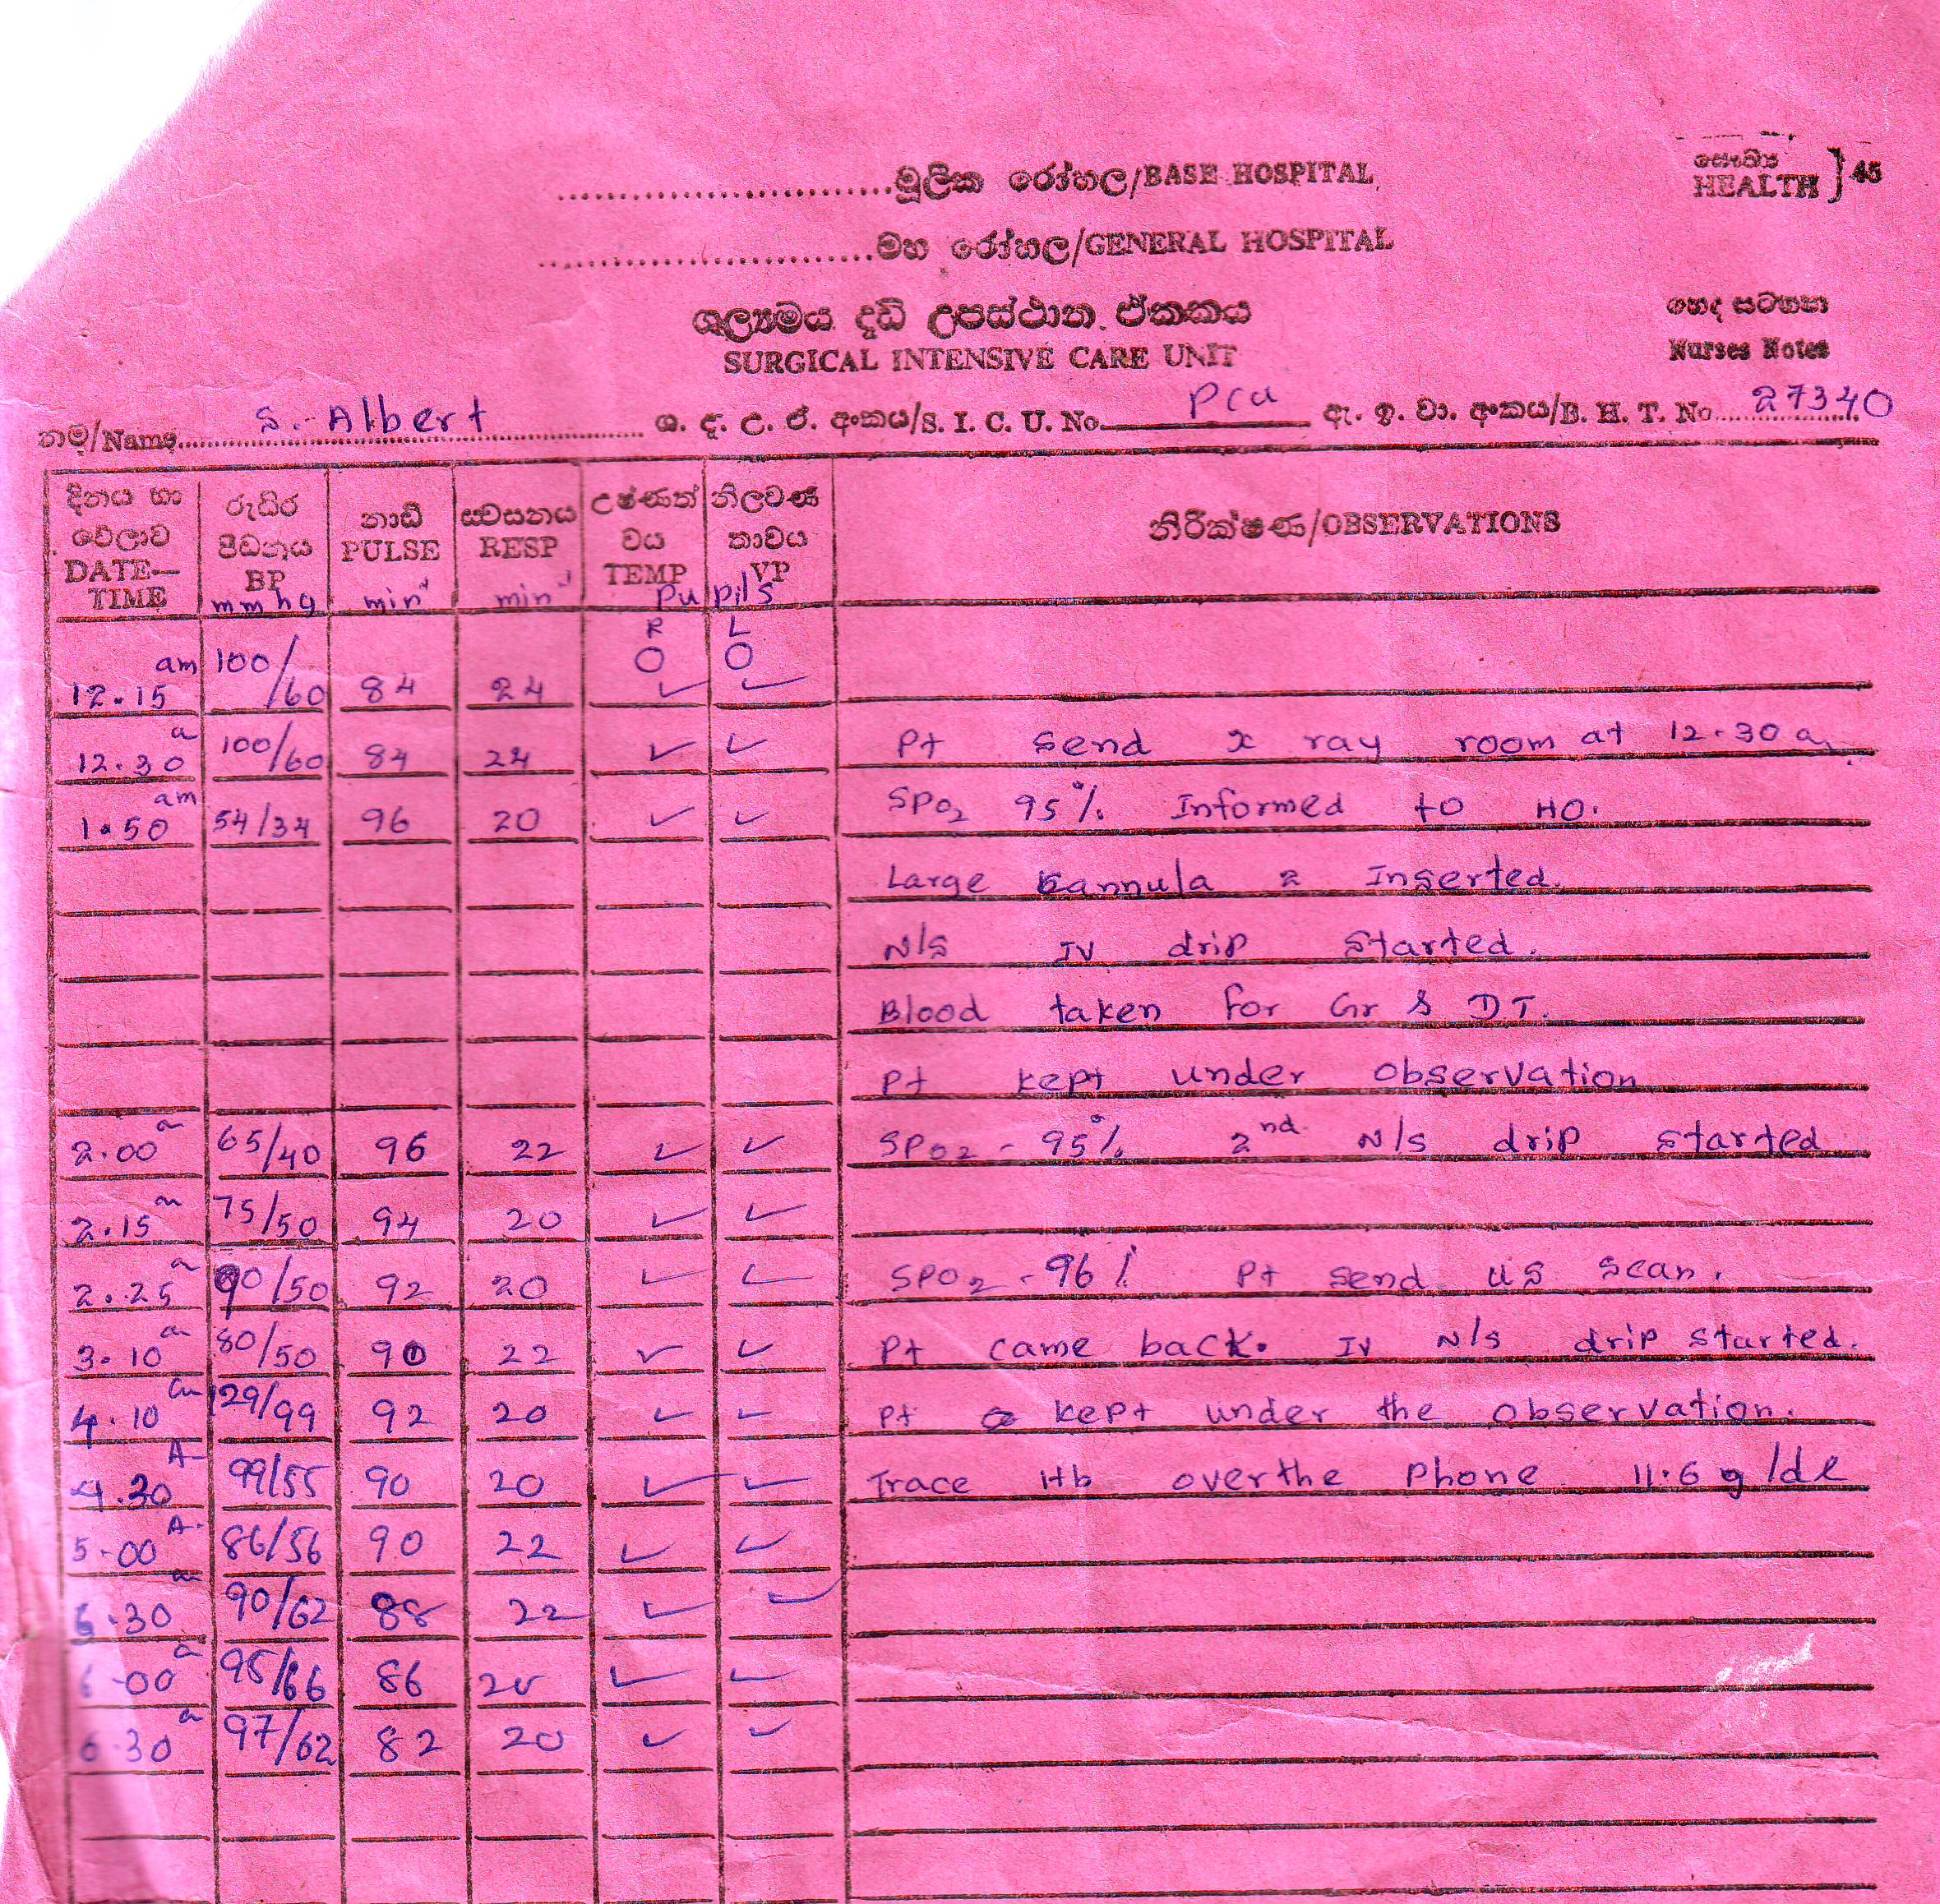

Slide 89
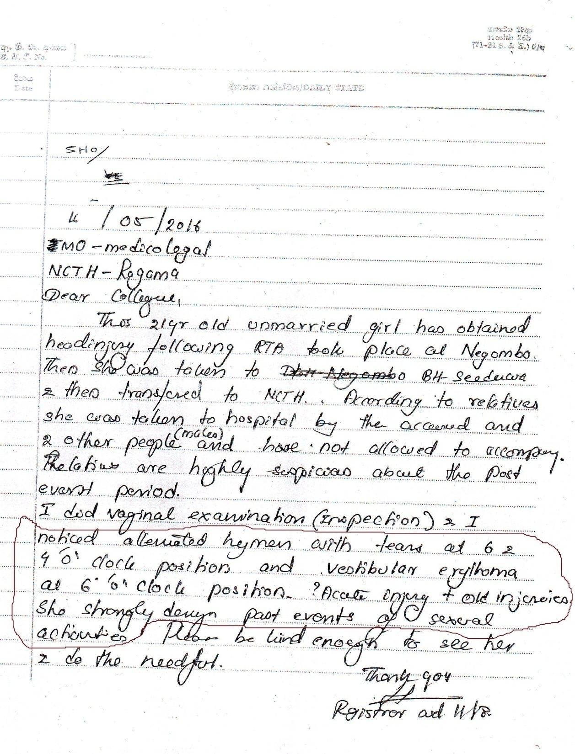

Slide 90
Questions?

Slide 91

THANK YOU!
Dr. Handun P. Wijewardena
MD (USSR), DLM (Colombo)
MD [Forensic Medicine] (Colombo)
Consultant JMO
Teaching Hospital
Ragama

